Slide 1

Cricket Player Performance Prediction: A Machine Learning
Mini project Review-3 Presented by
Name
Roll Number
B.Srikanth
21AG1A6708
Md.Shafee
21AG1A6743
M.Vijaya Lakshmi
21AG1A6748
A.Shravan Kumar
21AG1A6701
Under the supervision of Mr.K.Kiran Babu , Assistant professor.
CSE(Data Science)
ACE Engineering College

Slide 2

CONTENT
Introduction
Existing System & Proposed Model(Abstract)
Software Requirements
Hardware Requirements
Functional and Non-Functional Requirements
System Analysis
Sequence Design
Conclusion
References

Slide 3
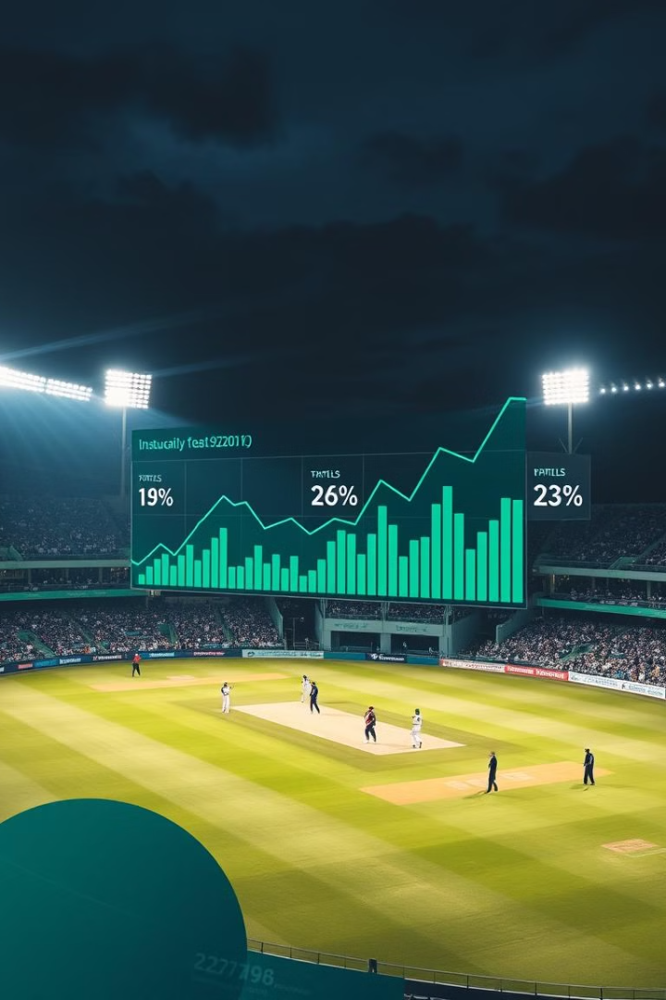
Introduction
This mini-project leverages machine learning to predict cricket player performance. It builds upon previous work in IPL team prediction, incorporating pitch reports as a crucial attribute. The project aims to enhance prediction accuracy by considering the significant impact of pitch conditions on match outcomes.

Slide 4
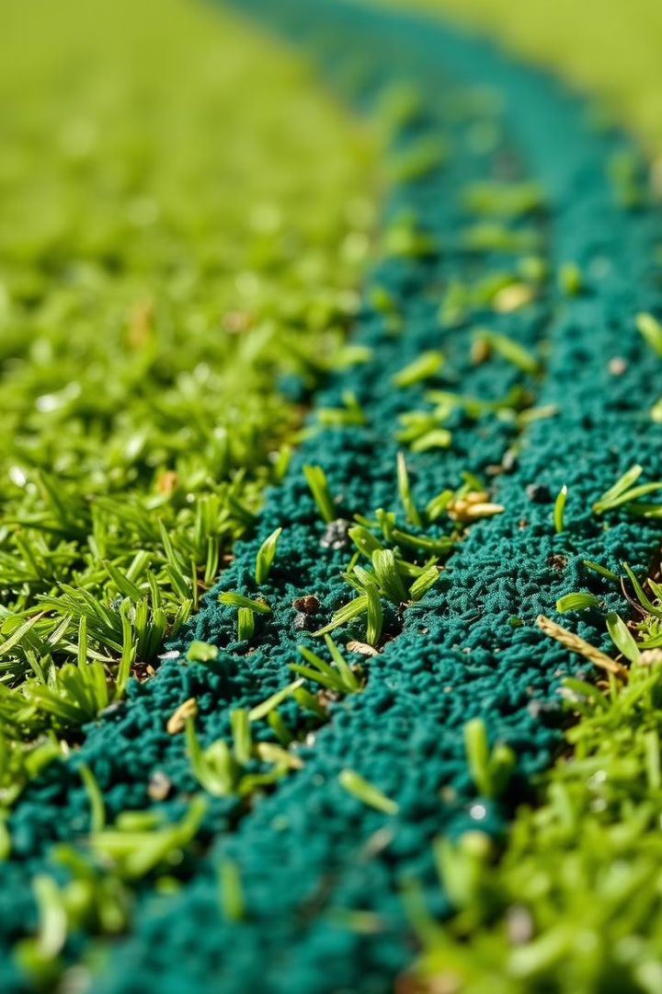
Existing System
In current systems for predicting cricket player or team performance, the focus is usually on historical player statistics, recent match performances, and team lineup details. Most systems analyze factors like:
Historical Performance Data: Leveraging past performance statistics (e.g., batting averages, bowling economy) to estimate future performance.
Player and Team Stats: Considerations include individual player strengths, team composition, and match conditions based on historical records.
Basic Machine Learning Models: Simple algorithms like decision trees or logistic regression are sometimes used but often lack sophistication in accounting for real-time match conditions.

Slide 5
Proposed problem
The proposed model predicts cricket player performance using the Light Gradient Boosting Machine (LGBM) for its speed and accuracy with structured data. It involves collecting historical player stats, match details, and environmental factors, followed by preprocessing and feature engineering to extract meaningful insights. The model is trained using cross-validation and fine-tuned for optimal performance. Evaluation metrics like RMSE and F1-score assess its accuracy, depending on the task. Finally the model is deployed as an API or integrated into platforms for real-time insights and visualization.

Slide 6
Software Requirements
Software Requirements
Operating System: Windows, macOS, or Linux
Programming Language: Python
Libraries:
Data Processing: Pandas, NumPy
Machine Learning: Scikit-Learn
Data Visualization: Matplotlib, Seaborn
Model Evaluation: SciPy
Development Environment: Jupyter Notebook, PyCharm, or VS Code
Data Sources: Cricbuzz API, or data files in CSV/YAML format for match and player statistics

Slide 7

Hardware
requirements
Hardware Requirements
Processor: Intel i5 or equivalent (minimum)
RAM: 8 GB (minimum), 16 GB recommended for faster processing
Storage: At least 20 GB of free disk space for datasets and model storage
GPU: Optional, but recommended for faster model training, especially for large datasets

Slide 8

Functional requirements
Performance Analysis:
Extract features from batsman and bowler data for predictive modeling.
Analyze historical and contextual factors (e.g., pitch type, venue) impacting performance.
Prediction Module:
Train the model using algorithms like SVM and Random Forest.
Accept user inputs (team, opponent, venue) and generate performance predictions.
User Interface:
Provide a simple interface for users to input teams, venues, and other match details.
Display a list of predicted top performers based on input and analysis.

Slide 9
Non-functional requirements
Performance:
Ensure fast data processing and model training, with predictions generated within seconds.
Usability:
Design a user-friendly interface that simplifies data input and output interpretation.
Reliability:
Maintain accurate predictions through consistent model performance and data integrity.
Scalability:
Allow for easy expansion to include additional features or data sources in the future.

Slide 10
System Analysis
In this phase we will try to understand the problem statement :
Problem Definition
Requirements
Data Analysis
Model Requirements

Slide 11
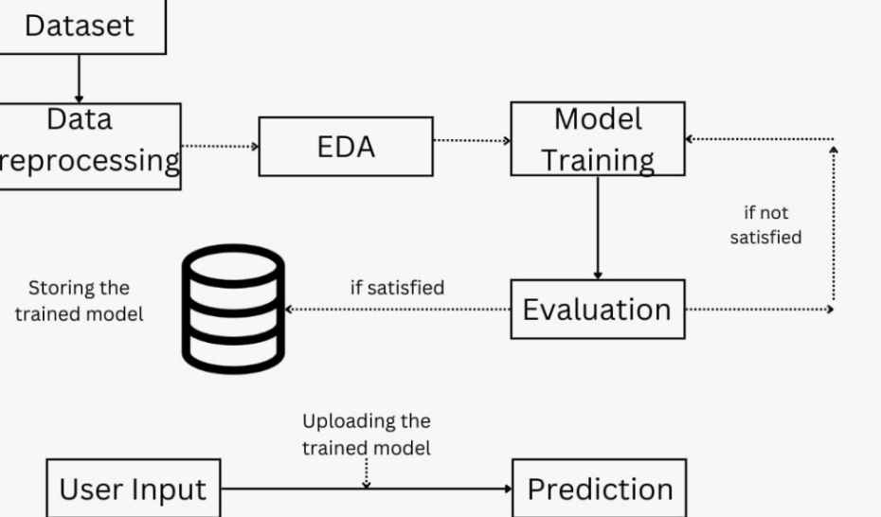
System Architecture

Slide 12
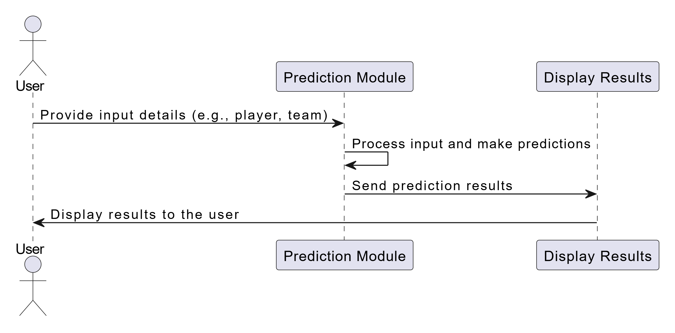
Sequence – diagram

Slide 13
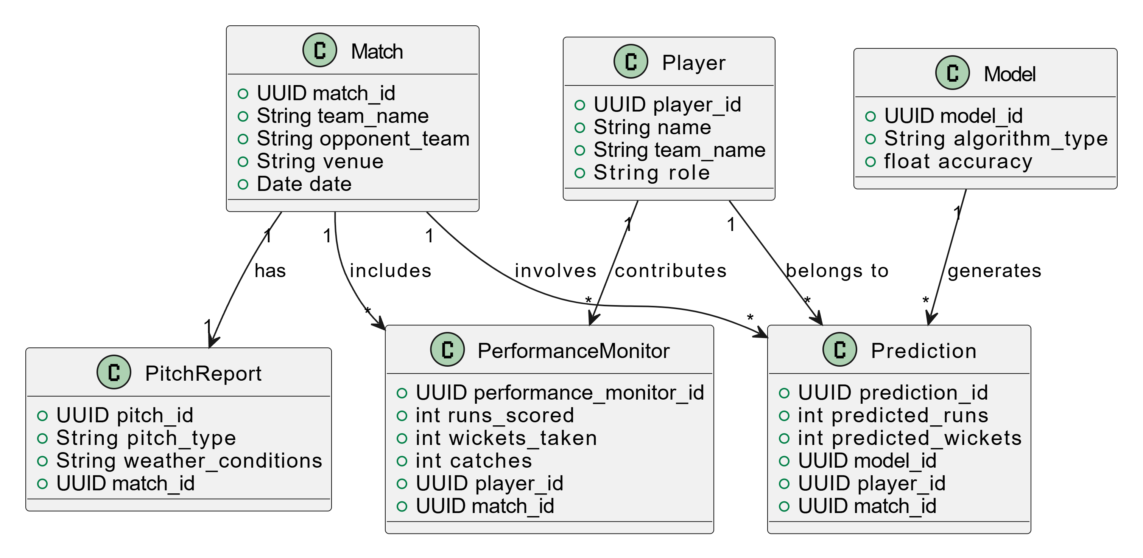
Class – diagram :

Slide 14
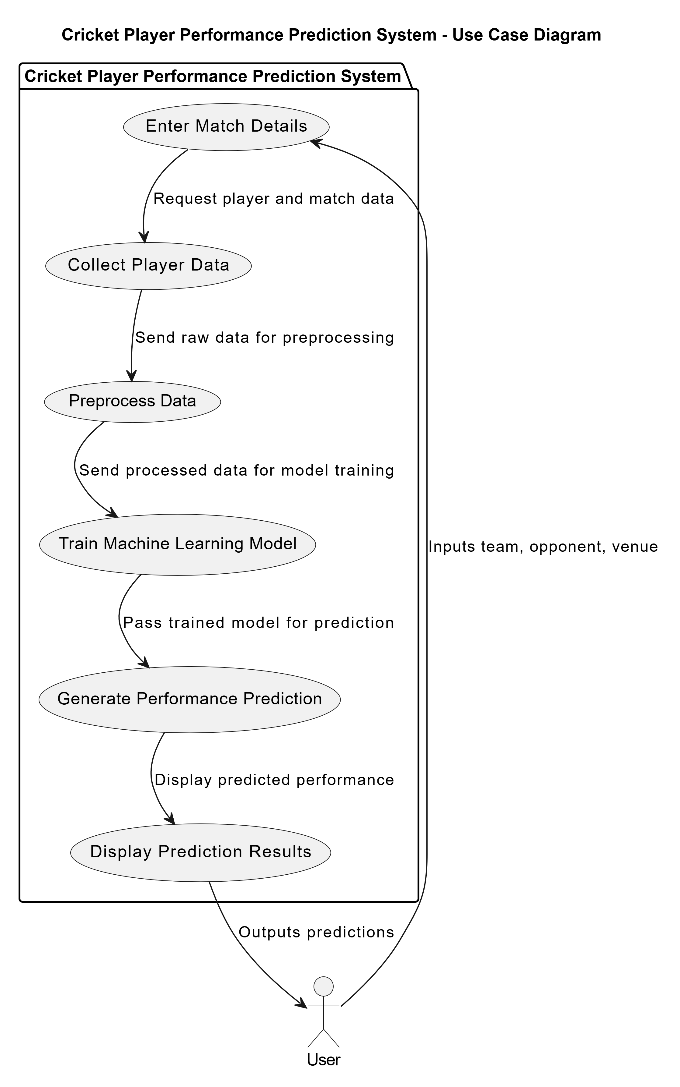
Use Case – diagram :

Slide 15
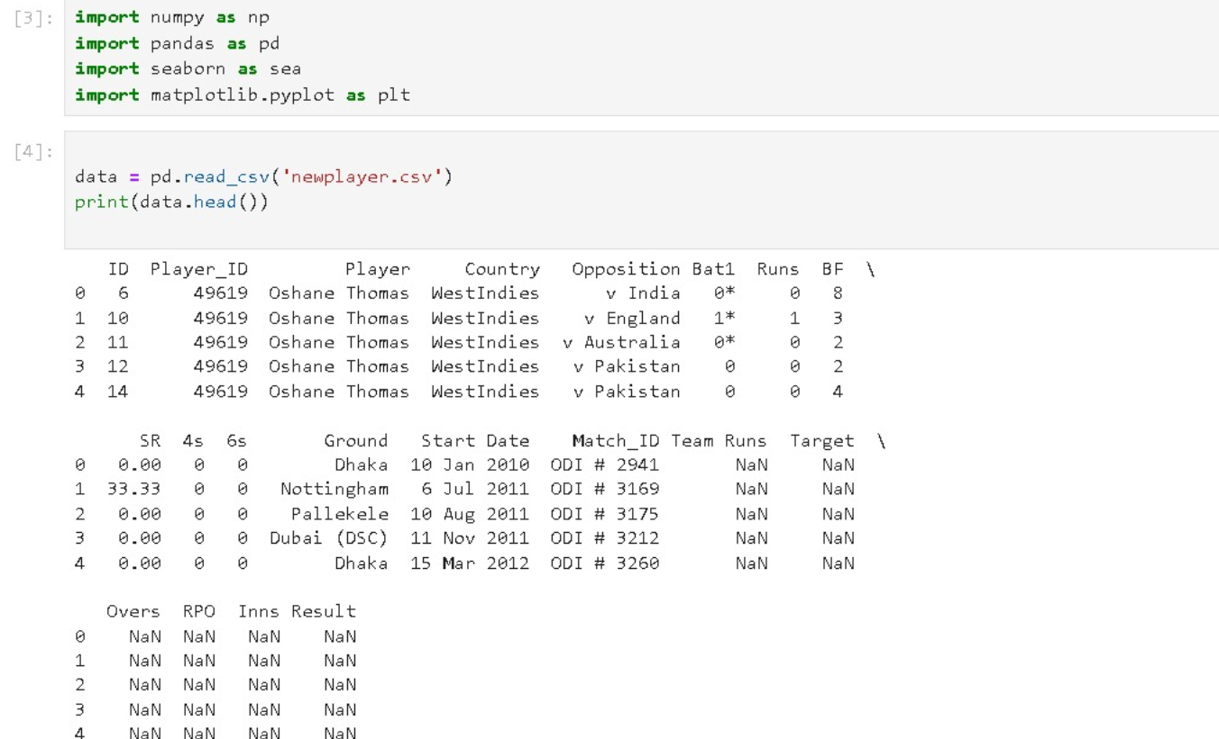
Data Set Loading

Slide 16
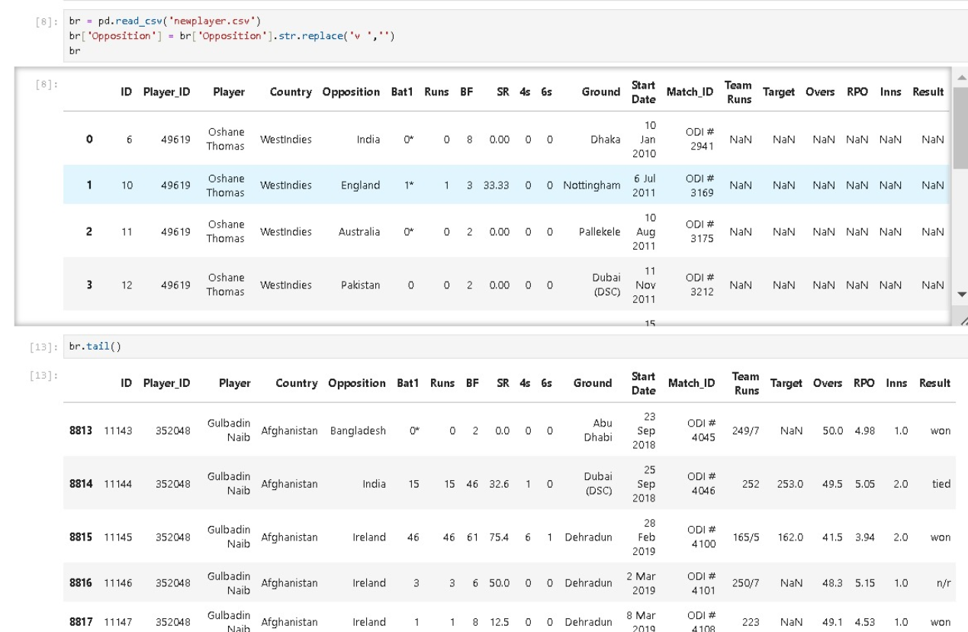
Pre-Processing

Slide 17
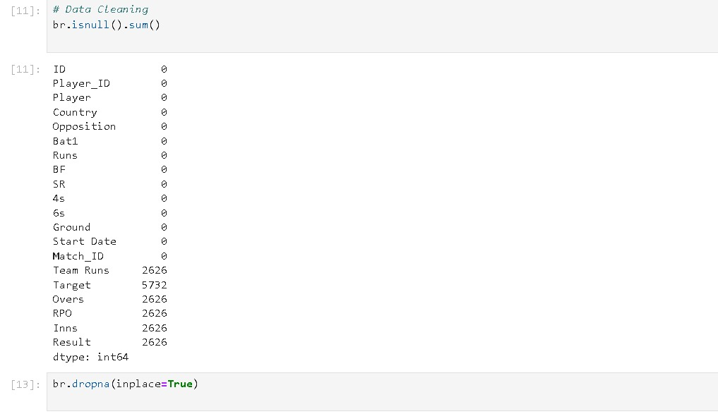
Pre-Processing(data cleaning)

Slide 18
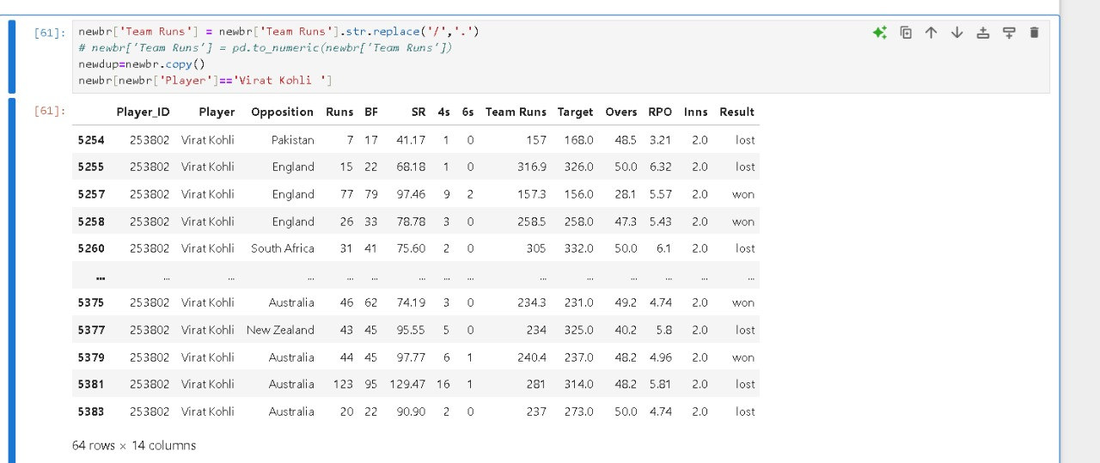

Slide 19
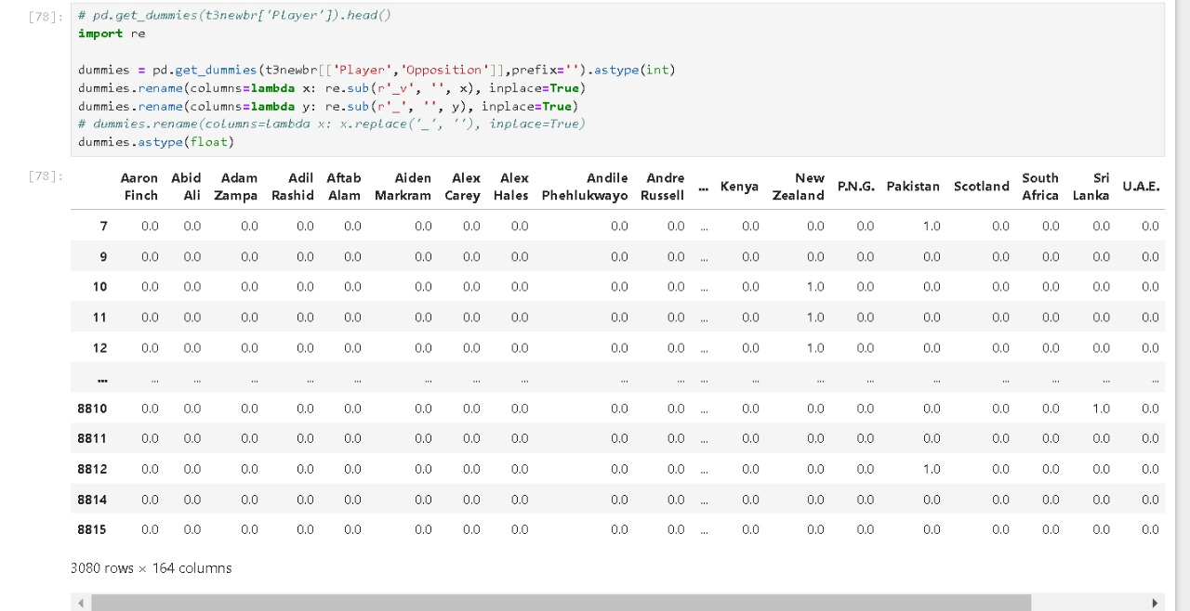
Data Preprocessing(Feature Engineering)

Slide 20
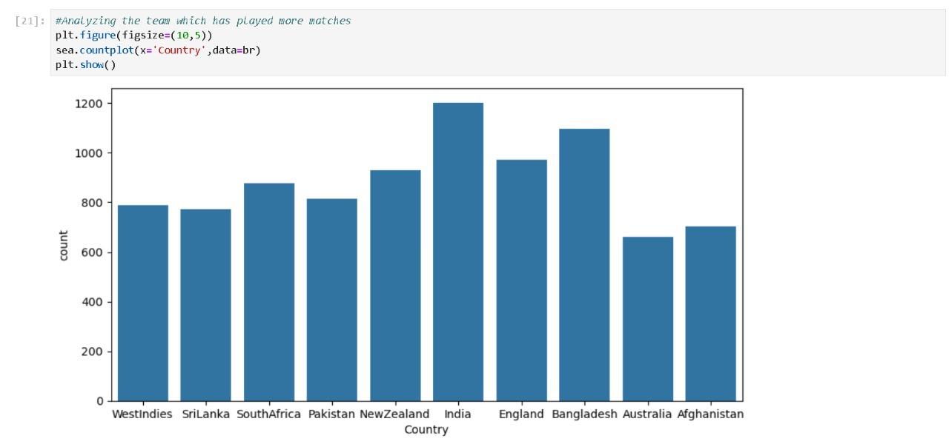
Analyzing

Slide 21
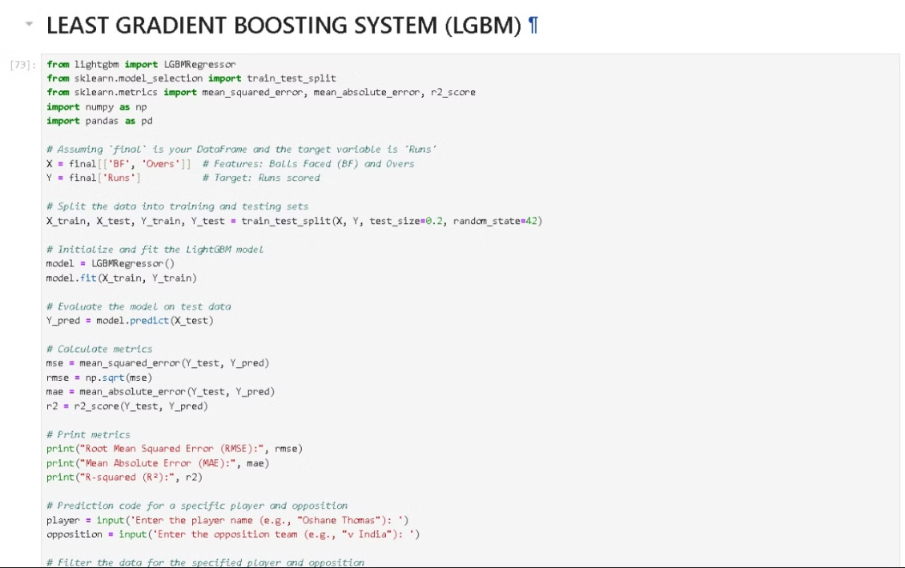
Model Building

Slide 22
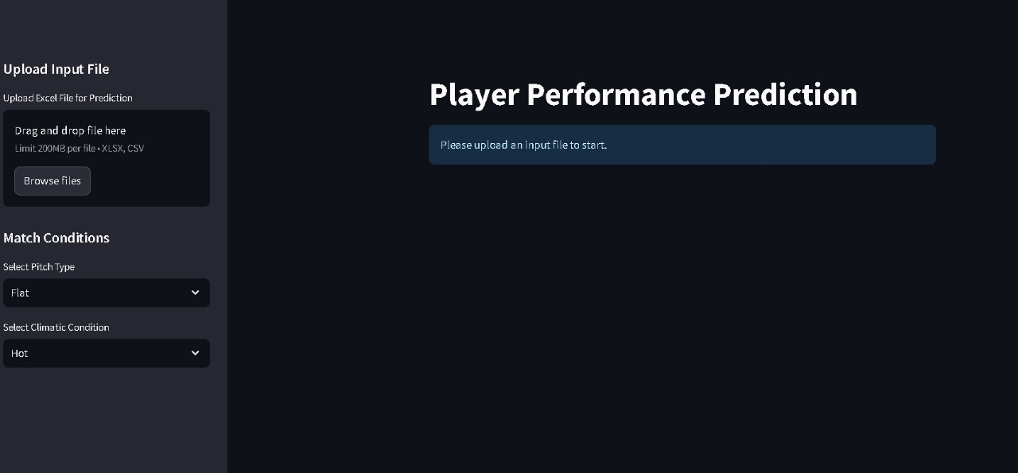
User Interface

Slide 23
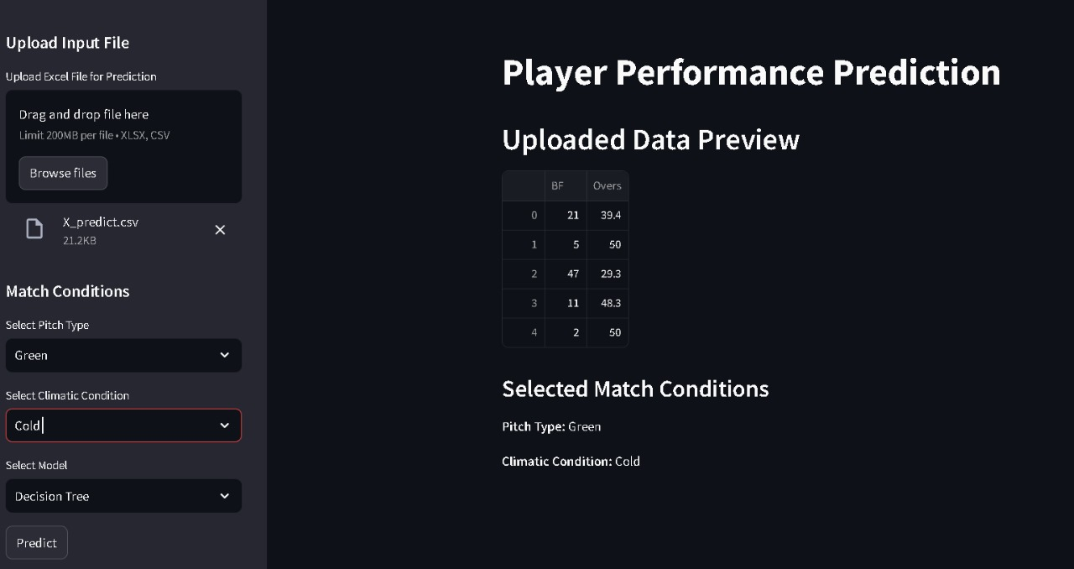

Slide 24
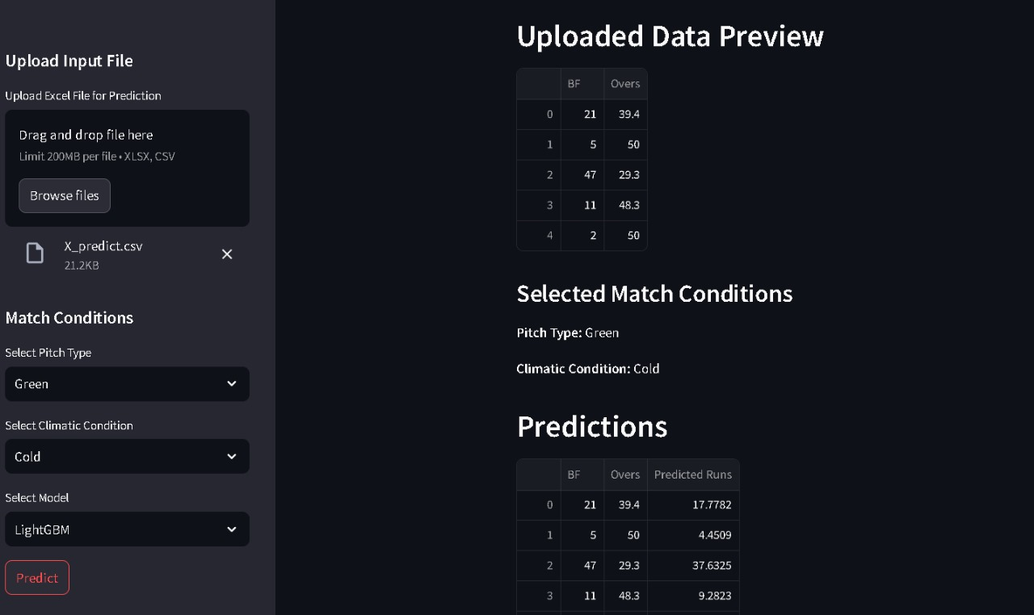

Slide 25
Conclusion
predict cricket player performance in terms of runs, utilizing advanced modeling techniques and detailed data preprocessing. Through meticulous exploratory data analysis (EDA), the dataset's key patterns and trends are uncovered, enabling the creation of meaningful features that enhance model accuracy.
The predictive models, specifically a Decision Tree and LightGBM, are trained to estimate player performance based on contextual match details such as pitch type, weather conditions, and opponent strength. Model evaluation metrics indicate their reliability and accuracy in making predictions. Additionally, the integration of user-friendly tools like Streamlit showcases how machine learning models can be deployed as an interactive application, making the insights accessible to users in real time.
Overall, the project demonstrates the practical application of machine learning in sports analytics, paving the way for data-driven decisions in cricket match strategies. By integrating dynamic data inputs with robust models, it provides a valuable tool for performance forecasting and strategic planning in the cricketing domain.

Slide 26
References
Cricket player peformance

Slide 27
Thank you

